Slide 1
JavaScript
Week 4

Slide 2
JavaScript
JavaScript is a scripting language of the web.
Web evolves from a static to a dynamic environment,
Static markup and styling to dynamic interfaces and advanced interaction.
Once seen as optional, JavaScript is now becoming an integral part of the web applications

Slide 3
JavaScript (JS) is a cross-platform, object-oriented programming language used by developers to make web pages interactive. It allows developers to create dynamically updating content, use animations, pop-up menus, clickable buttons, control multimedia, etc.
What Makes JavaScript So Popular?
Nearly every computing device that we use today has the use of JavaScript – iPhones, Androids, Mac OS, Windows, Linux, and Smart TVs. The significant reasons why JavaScript became universally adopted for web development include:
It can be used both in the front-end and back-end of web development
Serves everyone from beginners to intermediate and even advanced developers
Can run on all devices
It does not need an environment setup
Standardized and gets frequently updated with new versions
Works with Document Object Model (DOM) for response to user interactions
Transformed web browsers into application platforms
Wide range of frameworks and libraries to help build complex applications

Slide 4
Definition of the JavaScript
Definition from Wikipedia that JavaScript is a high level dynamic, untyped and interpreted programming language standardized in the ECMAScript language specification, that alongside HTML and CSS is one of the three core technologies of world wide web content.

Slide 5
Explanation
HTML handles the content.
CSS is presentation.
That means, even if you take the CSS away the content is still there.
CSS is the presentational enhancement. The third layer is the JavaScript.

Slide 6
Where is our JS ?
JavaScript is a scripting language that runs in the browser and interacts with the HTML Markup and CSS Rules to change what you see and what you can do.

Slide 7
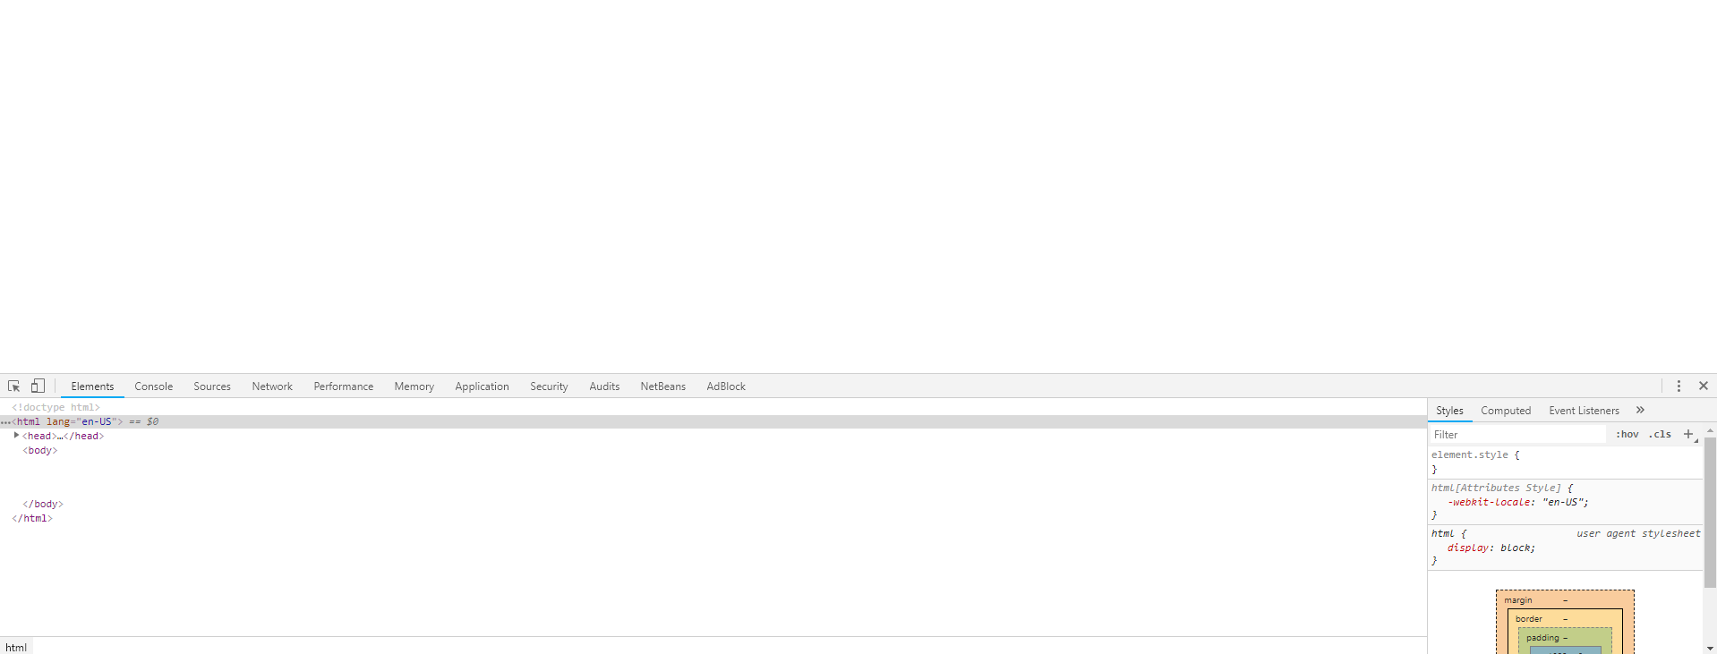
Tools to use in our JS
Open attached index.html (Blackboard week 4) in the Chrome browser
Right click inspect

Slide 8
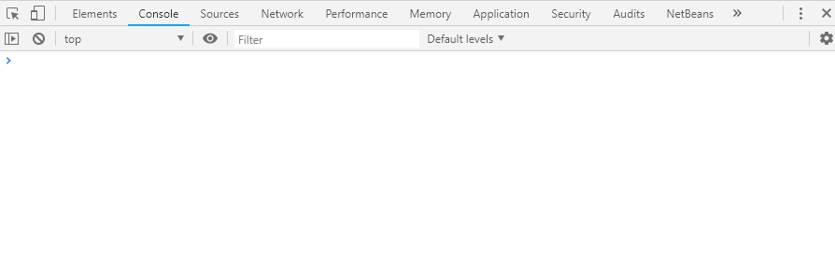
Press console (how it looks below)

Slide 9
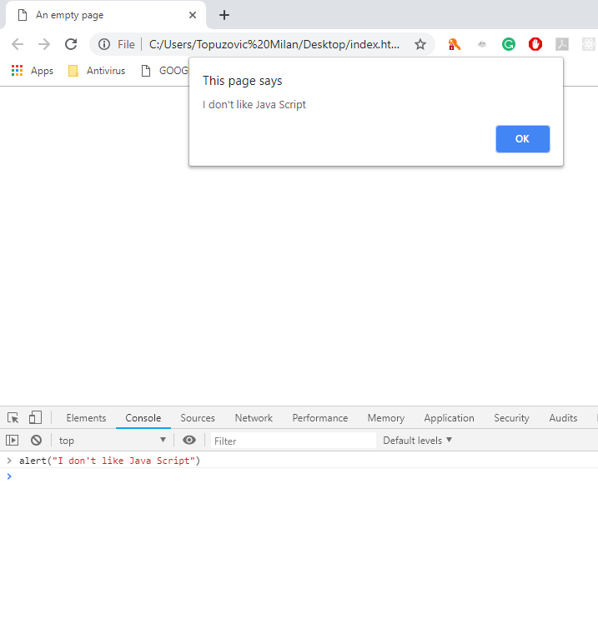
Let me start with alert

Slide 10
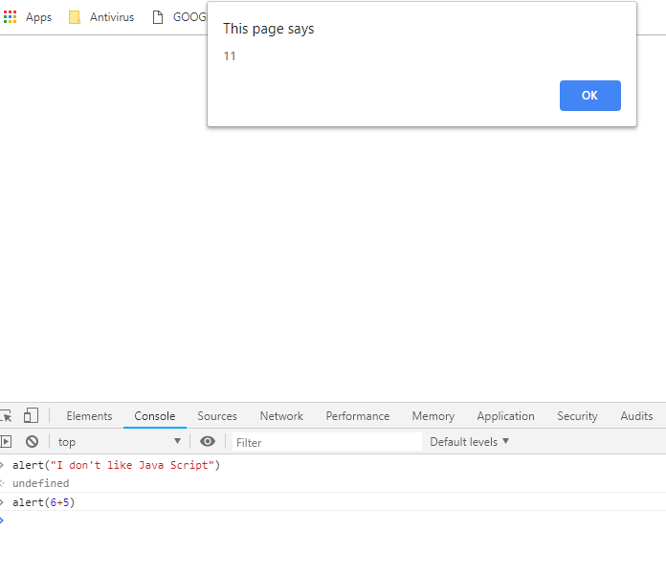
Basic math

Slide 11
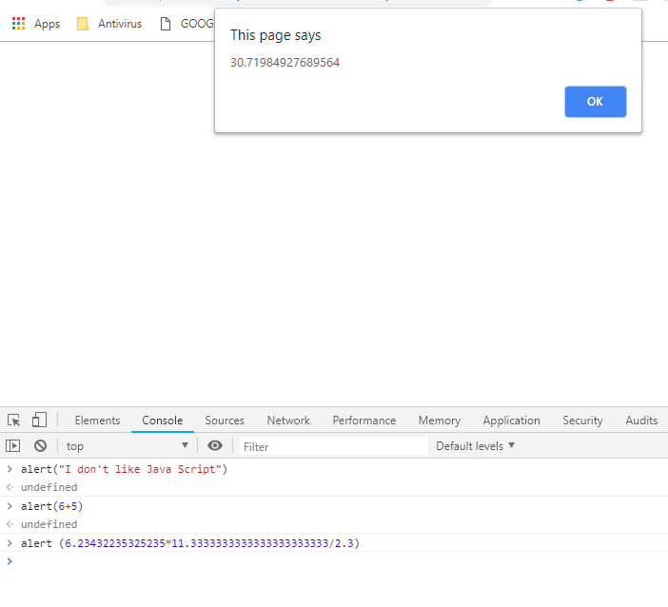
Advanced math

Slide 12
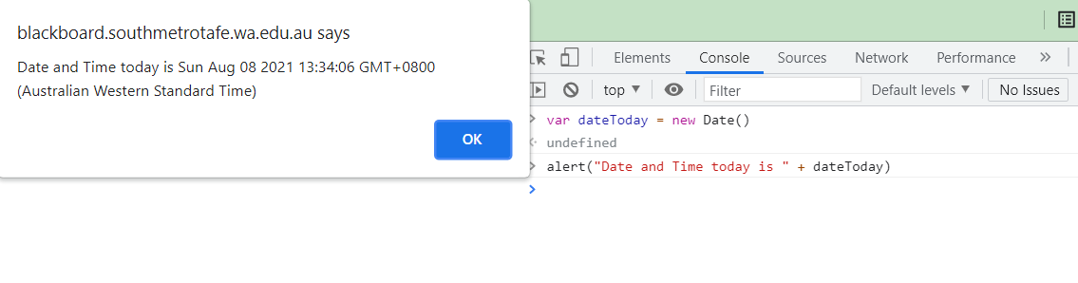
How about I find out date and time from my server?

Slide 13
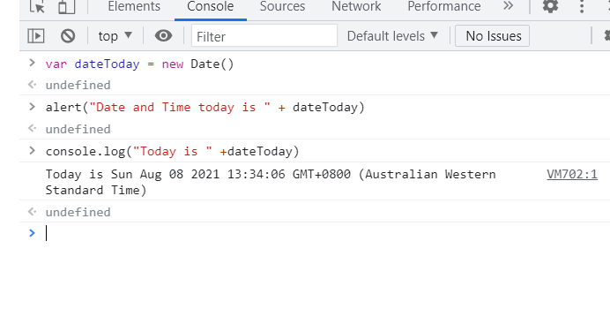
How about we print this output in our console?

